Slide 1

Student Details
Name: DODDI SRI HARI SAI KUMAR
Skills Build Email Id: dsriharisaikumar@gmail.com
College Name: Dadi Institute of Engineering and Technology
College State: Anakapalli, Andhra Pradesh
Internship Domain: Artificial Intelligence & Machine Learning
Start & End Date: 5th June 2023 – 23th July 2023

Slide 2
Employees Burnout
Employees burnout refers to a state of chronic physical, emotional, and mental exhaustion caused by prolonged and excessive stress in the workplace.
It is characterized by feelings of fatigue, cynicism, and a reduced sense of accomplishment or efficacy.
Burnout is often a result of prolonged exposure to high work demands, a lack of control or autonomy, insufficient support or resources, and a mismatch between an individual's expectations and the actual work environment.
It can have significant negative effects on an employee's well-being, job performance, and overall quality of life. Common symptoms of burnout include emotional exhaustion, depersonalization, decreased motivation, and a diminished sense of personal accomplishment.
Addressing employee burnout is essential for promoting employee well-being, maintaining productivity, and creating a positive work environment.

Slide 3
Agenda
The main aim of the project is to predict the Burn Rate of the employees.
By using the Machine Learning Algorithms we can able to predict the Burn Rate of an employee.
It will be useful to the companies to know the health of there employees.
So the companies can able to adjust the works and giving the employees a peaceful environment to work.

Slide 4
Project Overview
This project is done basing on the Employees burnout analysis dataset.
The dataset consists of features like Employee ID, Date of Joining, Gender ,Company Type, WFH Setup Available , Designation, Resource Allocation, Mental Fatigue Score, Burn Rate.
By using the Machine Learning we are training the model given dataset as an input that is useful to predict the Burn Rate for the future employees.
We use Linear Regression, Random Forest Regressor, Ada Boost Regressor algorithm to train the model.
We uses PCA(Principal Component Analysis) to change the dimensions of the dataset.
The companies can able to identify the problems of the employees and they can provide better suitable environment for work.

Slide 5
Who are the end users of this project?
This project is beneficial to the companies.
The end users are the companies.
By this project the companies may able to about the employees health and their needs.
So the companies can able fulfil the needs of the employees.
Human Resources Departments, Managers & Supervisors , Organizational Leaders, Occupational Health and Safety Professionals are also beneficial by this project.

Slide 6
YOUR SOLUTION AND ITS VALUE PROPOSITION
.
Promote Work-Life Balance
Prioritize Workload Management
Foster Supportive Work Environment
Provide Adequate Resources
Offer Training and Skill Development
Recognize and Reward
Encourage Breaks and Rest
Support Well-being Initiatives
Foster Career Growth

Slide 7
How did you customize the project and make it your own
We can observe that most of the employees are works in Service based Company.
More number of employees are wishing to WFH(Work From Home).
There are slightly more number of Female employees than male employees.
The Designation having 4,5 having more Burn Rate compared to the remaining designation.
I have used 3 Regression models Linear Regression, Random Forest Regressor, Ada Boost Regressor.
Most of the employees 1555 having the Burn Rate in range 0.445-0454.Maximum of the employees in these are belongs to the designation of 1,2,3.
Mental Fatigue is more for the Designation 4,5.
Considering research papers I have implemented the 3 regression algorithms mentioned above to get more accuracy.

Slide 8
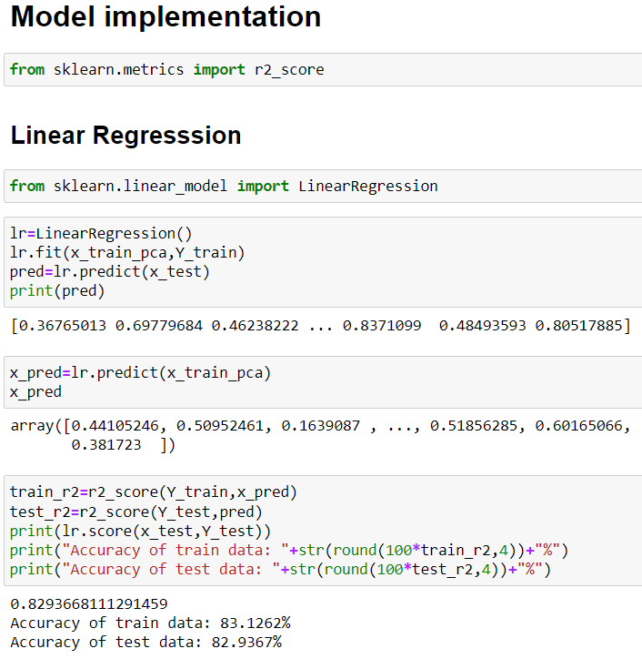
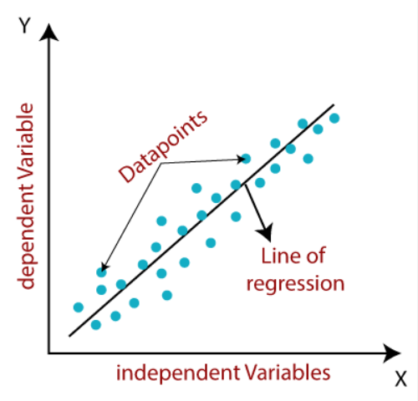
Modelling
Linear Regression:
Linear regression analysis is used to predict
the value of a variable based on the value
of another variable.
Formula:
Y = a + bX
where
X is the independent variable
Y is the dependent variable
The slope of the line is b
a is the intercept

Slide 9
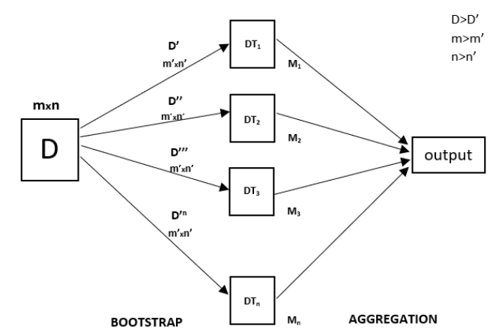
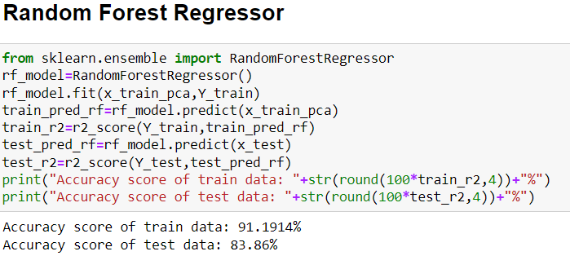
Random Forest Regressor:
Random Forest is an ensemble technique capable of performing both regression and classification tasks with the use of multiple decision trees and a technique called Bootstrap and Aggregation.

Slide 10
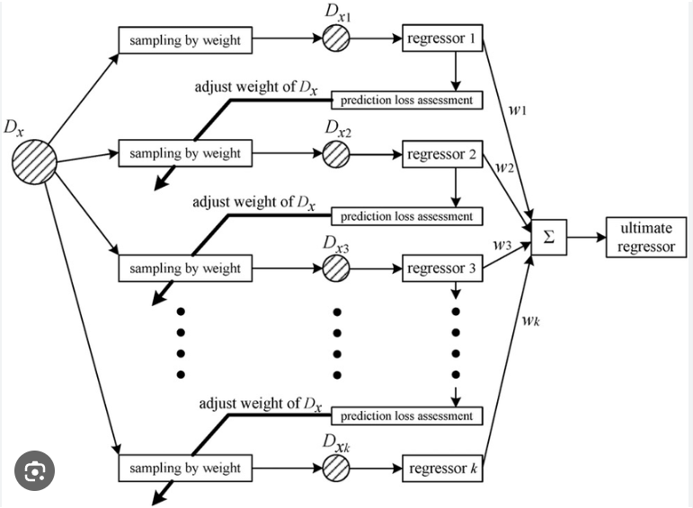
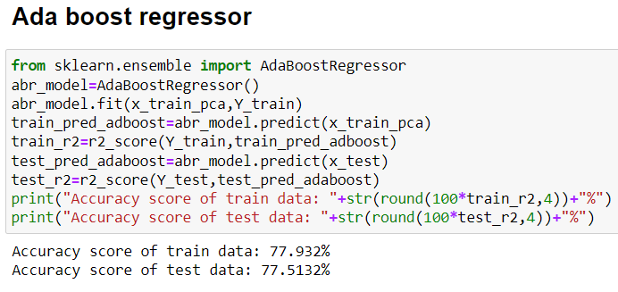
Ada Boost Regressor:
An Ada Boost regressor is a meta-estimator that begins by fitting a regressor on the original dataset and then fits additional copies of the regressor on the same dataset but where the weights of instances are adjusted according to the error of the current prediction.

Slide 11
Results
We can observe that Linear Regression having 82% Accuracy, Random Forest Regressor having 83% and Ada Boost Regressor having 77%.
So by using these regression models we can able to predict Burn Rate.
By observing the results the companies can decrease the Burn rate by decreasing the workload, providing the more Resources to the employees, providing WFH those who need, by implementing Employees Assistant programs, providing Stress Management and Resilience Training, Regular Feedback and Communication, conducting Health and Wellness Initiatives.

Slide 12
Links
For more details visit my GitHub Repository.
https://github.com/SRIHARISAIKUMAR/Internship_project/blob/main/Internship%20Project.ipynb
Or
https://github.com/SRIHARISAIKUMAR/Internship_project

Slide 13
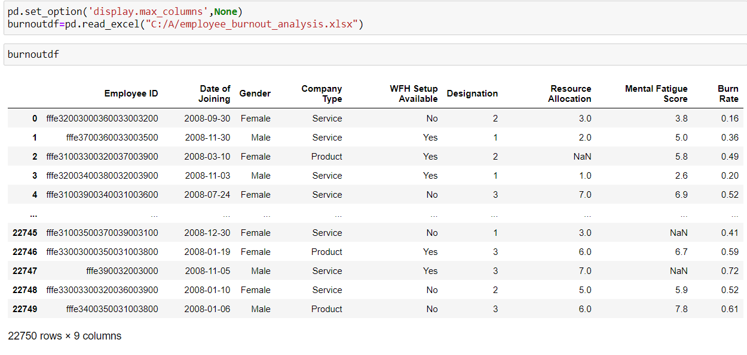
Importing Dataset
Data set can be imported by using pandas.
Pandas is a library in python where we can import the dataset and convert it into a Data Frame.

Slide 14
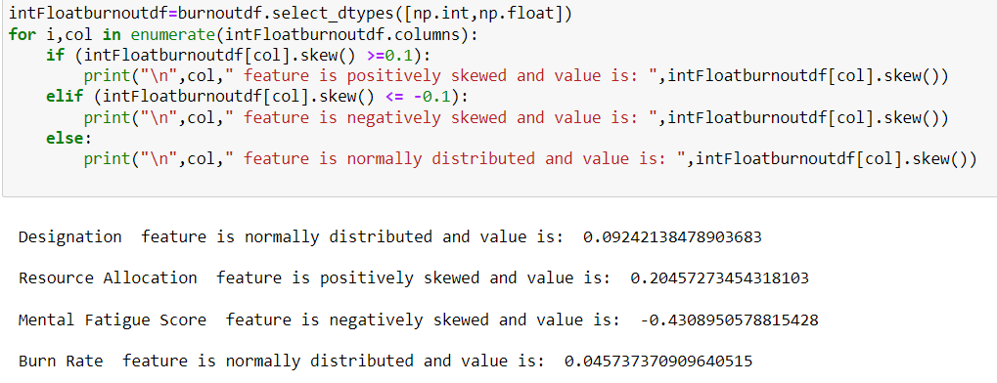
Skewness of the columns

Slide 15
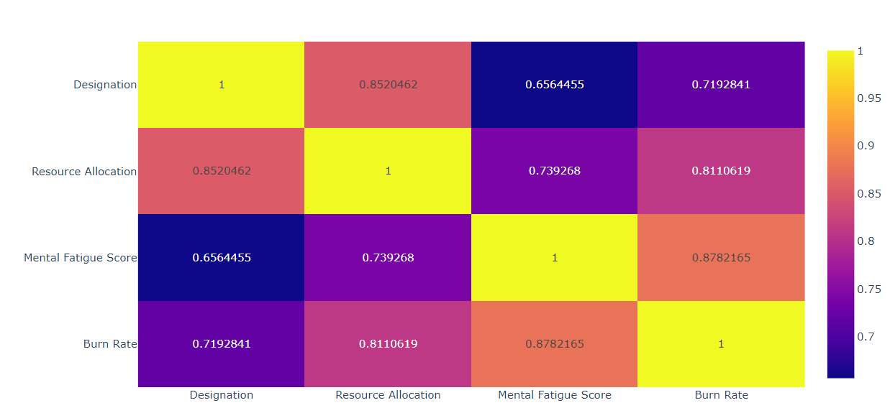
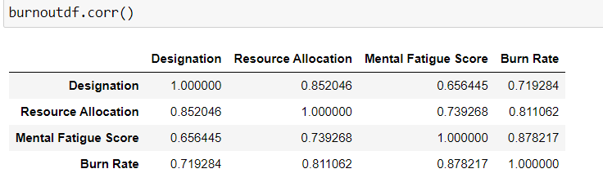
Correlation
We can see the Correlation among the columns below.

Slide 16
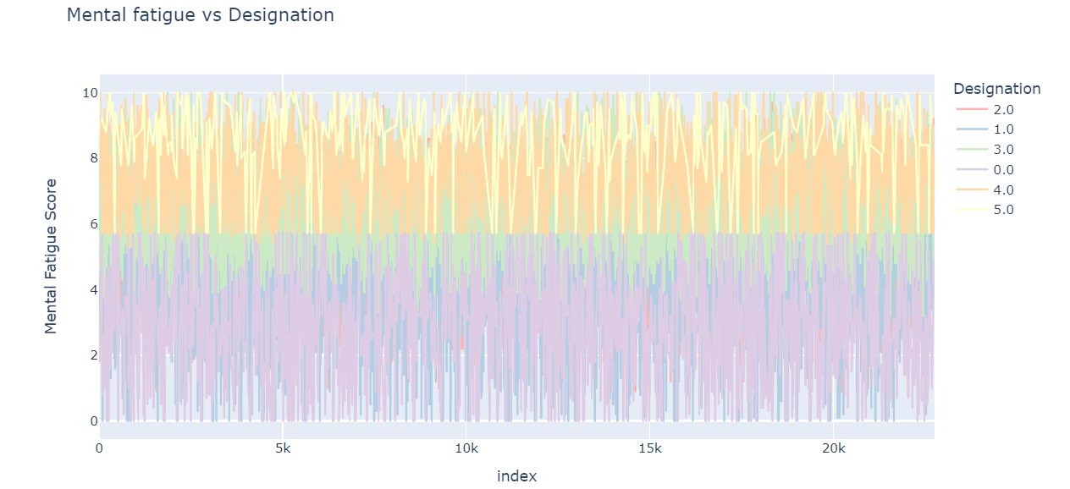
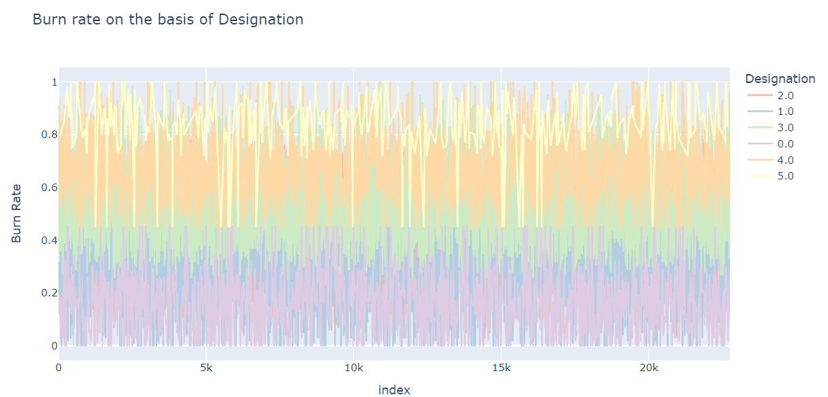
Relation among Mental Fatigue ,Designation, Burn Rate

Slide 17
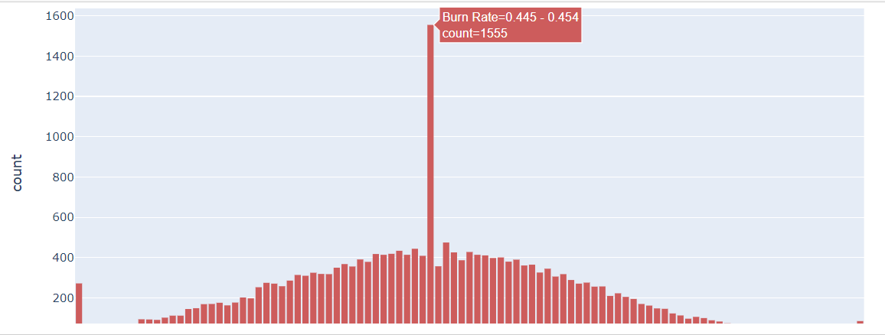
Maximum Burn Rate count
We can observe that the Burn Rate range between 0.445 to 0.454 having more number of employees.

Slide 18
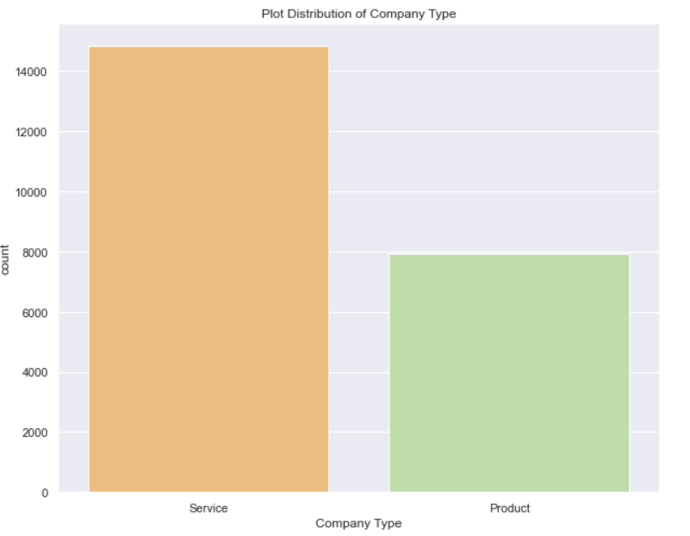
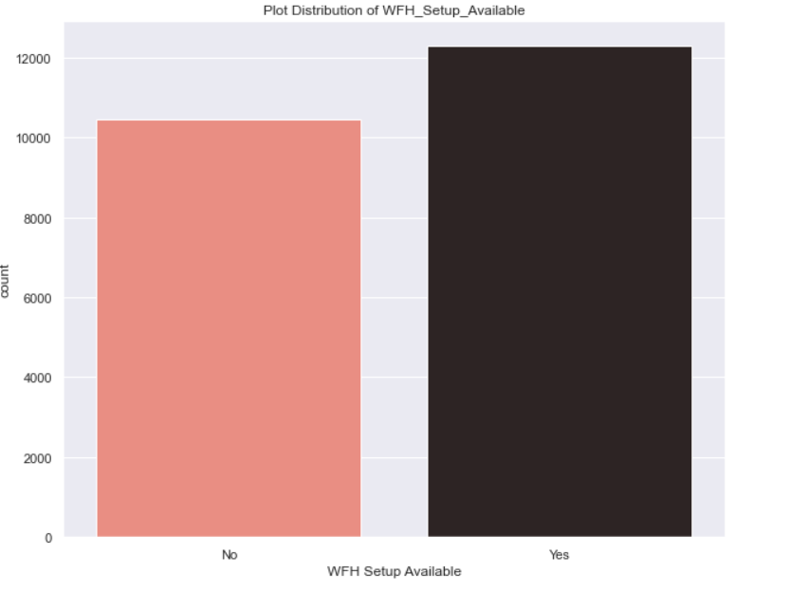
About WFH
We can observe that there are more number of employees working in Service companies and more number of employees are wish to WFH(Work From Home).

Slide 19
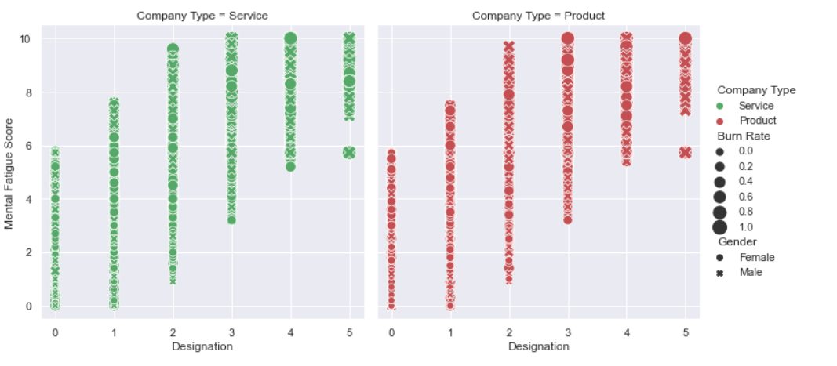
Burn Rate of Both type of Companies

Slide 20
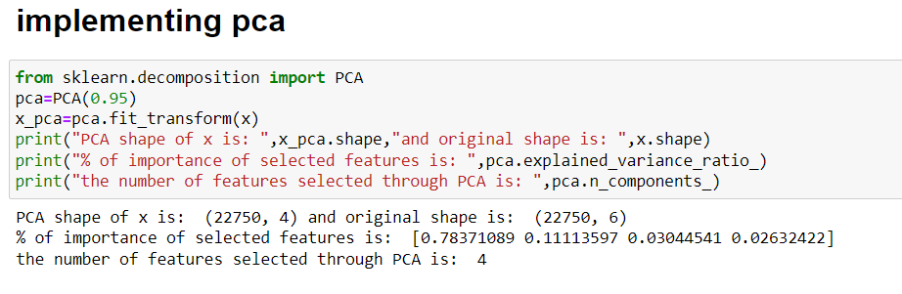
Implementation of PCA
Applying Principal Component Analysis(PCA) which helps to reduce the shape of the dataset.
The columns are reduced for the model implementation.
Here Nine columns are reduced to Four columns

Slide 21
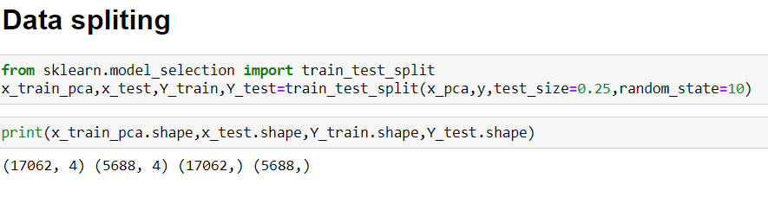
Splitting the Dataset
By using sklearn library we has to import train_test_split method and give the dataset as a input to the method.
So it will split into 4 parts x_train, x_test, y_train, y_test.
We can also fix the test size by using test_size attribute.
Random state defines the randomness of the dataset.

Slide 22
Linear Regression
Linear Regression is Supervised learning Technique which is used to predict continuous values.
Here we import linear regression from sklearn and we created a model lr and given training data.
So the model trains the data and able predict the burn rate.
By using the r2 score we can able to know that accuracy of the model of both train and test data.

Slide 23
Random Forest Regressor
Random Forest Regressor is an ensemble technique.
Random Forest consists more than one number of Decisions trees.
Random Forest Regressor Algorithm is used to predict the Burn Rate.

Slide 24
Ada Boost Regressor
Ada Boost Regressor is an ensemble technique.
Here we created a model using AdaBoostRegressor.
And we applied training data to it.
It will helps to predict the Burn Rate.

Slide 25
Libraries used
We used the following libraries in this project.
Warnings
Pandas
Numpy
Seaborn
Matplotlib
Sklearn
Plotly

Slide 26
Thank You

